Slide 1
Intro to Forensics
Albert morris

Slide 2
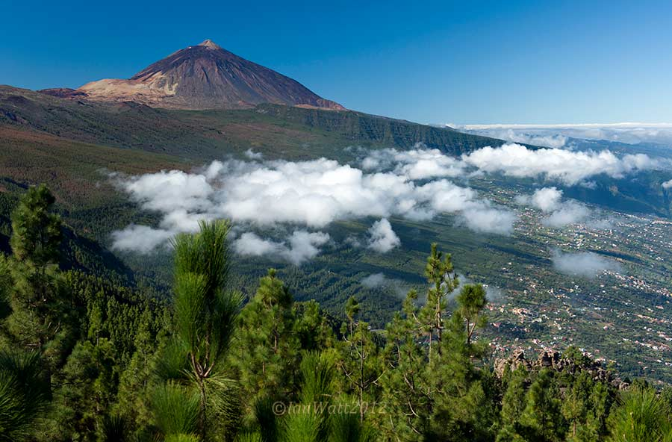
~whoami
Cal Poly Pomona - Information Security and Forensics
Director of Digital Forensics- FAST
From Spain, Tenerife
https://www.linkedin.com/in/albert1337
Twitter: @cubaa15

Slide 3

FAST- Forensics and Security Technology
Security focused CPP Club
Hands on workshops by students for students
Semesterly CTF’s
Connected to Industry professionals
Student chapter of the High Technology Crime Investigation Association (HTCIA)
Opportunity for like minded students to learn and grow
https://www.cppfast.org/
https://htcia.org/about/

Slide 4
Forensics Basics
Forensics = application of science to solve a legal problem.
electronic discovery (eDiscovery) = any process in which electronic data is sought, located, secured, and searched with the intent of using it as evidence in a civil or criminal legal case.
Involves the analysis of images, video, and audio encompassing computers, mobile devices, networks, and the cloud.
The analysis focus on authenticity, comparison, and enhancement.
Mainly used in criminal investigations, Civil Litigation, and Intelligence
“The best scientific evidence in the world is worthless if it’s inadmissible in a court of law.”

Slide 5
Dennis Rader AKA BTK(Bind, Torture, Kill)
Murdered people in Kansas from 1974 to 1991
Managed to avoid capture for 30 years
He sent a letter confessing a crime and asked to contact police via a floppy disk
Floppy disk was analyzed for metadata with the following findings:
Date Created: Thursday, February 10, 2005 6:05:34 PM
Dated Modified: Monday, February 14, 2005 2:47:44 PM
Title: Christ Lutheran Church
Last Saved By: Dennis
This metadata lead to the quick arrest of the President of the church, Dennis Rader

Slide 6
The Digital Forensics Process
Search Authority: warrant, subpoena, or even consent.
Chain of Custody: essential to maintain integrity
Imaging/Hashing Function: Forensic image duplicating original(Read only)
Validated Tools: Document tool testing + validations
Repeatability(Quality Analysis): Collection of practices + procedures throughout the whole forensic process helping guarantee accuracy of findings
Analysis: Timeline, breaking encryption, connect the dots….
Reporting: Know your audience! Executive summary, list items examined, methods + tools used, conclusion, relevant exhibits
Possible Expert Presentation: Present to judge or jury

Slide 7
File Systems + Volatility
File System’s job is to keep files allocated in an orderly way
FAT 12,FAT 16,FAT 32, FATX: File Allocation Table (USB)
NTFS: New Technology File System (Windows)
HSF, HSF+: Hierarchical File System (Mac)
Allocated Data: Used Spaced
Unallocated Data: Unused Space
Slack Space: when original file is partially overwritten, and the remains of unallocated space can be recuperated
Artifacts: items that get left behind based upon the activities of the end user of the device – footprints if you will.
Volatile Data: Live data that depends on power to stay alive (RAM)

Slide 8
Order of Volatility
CPU, cache, and register content
Routing table, ARP cache, process table, kernel statistics
Memory
Temporary file system/swap space
Data on hard disk
Remotely logged data
Data contained on archival media

Slide 9
Write Blocking + Evidence in Ram
Prevents any data from being written to the original evidence drive.
When cloning the original source of data it’s necessary to have a software of hardware write blocker to keep data’s integrity.
RAM can contain running processes, executed console commands, passwords in clear text, unencrypted data, instant messages, Internet protocol addresses, and Trojan horse(s)

Slide 10



Digital Forensic Tools
Open Source:
SANS Investigative Forensic Toolkit (SIFT)
The Sleuth Kit (Autopsy)
Volatility – Memory Analysis
Commercial
Forensics Tool Kit (FTK)
EnCase
Information that can be found:
E-mail addresses
Names
Phone numbers
Keywords
Web addresses
File types
Source https://en.wikipedia.org/w/index.php?curid=27739389 Source https://en.wikipedia.org/w/index.php?curid=37287879

Slide 11

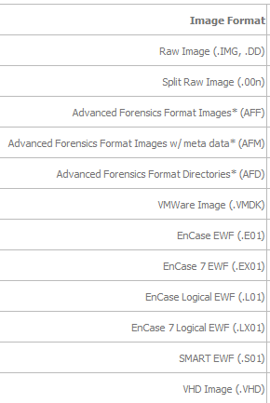
Forensic Image Formats
EnCase (extension .E01)
Access Data Custom Content Image (.AD1)
Raw dd (.001) Open Source
System image (.iso)

Slide 12
Incident Response (Network Forensics)
The National Institute of Standards and Technology (NIST) outlined the incident response cycle. The phases are:
Preparation: to respond quickly
Prevention: patching, network + host hardening
Detection and analysis: false positives are normal, get a picture of what the normal network traffic looks like
Containment, eradication and recovery: minimize impact
Post-incident activity: What did we do right/wrong? Are our policies effective? Is there a lack of resources to respond? What can we do differently?

Slide 13
Network continued…
Evidence: Logs and pcap files (if possible)
Logs of interest: authentication, application, operating system, and the firewall log.
Tools used:
NetIntercept
Netwitness Investigator
Snort
Wireshark

Slide 14
Workshop!!PDF Parsing
Start by placing the pdf on the desktop of the Kali VM
Right click desktop, open in terminal
Type:
pdfid python_textbook.pdf
peepdf python_textbook.pdf
pdf-parser python_textbook.pdf | grep .exe
pdfdetach -saveall python_textbook.pdf
Move byte-of-python.pdf to your windows OS(your host) and rename it to .exe from .pdf

Slide 15
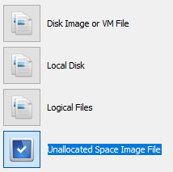
Workshop!! Autopsy
Open Autopsy
Click on New Case
Give it a name, it can be something like <Company>.<Instance> or anything you want
Fill in your information if you want, it will help for the report later on
Click on Add Data Source if the prompt does not appear automatically and select “Unallocated Space Image File”
Browse and selecte the .dd file, click next and Autopsy will take care of the rest

Slide 16
Workshop!! Wireshark Exercise
Open the 2017-01-28-traffic-analysis-exercise in Wireshark
Set up Wireshark columns with the pdf provided
Answer the following questions:
What was the date and time of the infection?
What is the MAC address of the infected Windows computer?
What is the IP address of the infected Windows computer?
What is the host name of the infected Windows computer?
What type of malware was the computer infected with?

Slide 17
Workshop!! Wireshark continued
Filters to use:
http.request See all the request made to a webserver
nbns See all the netBIOS traffic
dhcp

Slide 18
Workshop!! Wireshark continued Answers
What was the date and time of the infection?
A: The computer was infected on 2017-01-27 around 22:54 UTC.
Q: What is the MAC address of the infected Windows computer?
A: 5c:26:0a:02:a8:e4 (Dell_02:a8:e4)
Q: What is the IP address of the infected Windows computer?
A: 172.16.4.193
Q: What is the host name of the infected Windows computer?
A: Stewie-PC
Q: What type of malware was the computer infected with?
A: Ransomware

Slide 19
Resources
https://www.hackingarticles.in/step-by-step-tutorial-of-ftk-imager-beginners-guide/
Forensics Textbook: The Basics of Digital Forensics, The Primer for Getting Started in Digital Forensics, Second Edition By John Sammons

Slide 20
Training Resources
Forensics:
https://www.cfreds.nist.gov/
http://dftt.sourceforge.net/
Wireshark Exercise:
http://www.malware-traffic-analysis.net/2017/01/28/index.html

